Slide 1
Phylogeny - Evolutionary placement algorithm
Anders K. Krabberød
a.k.krabberod@ibv.uio.no

Slide 2
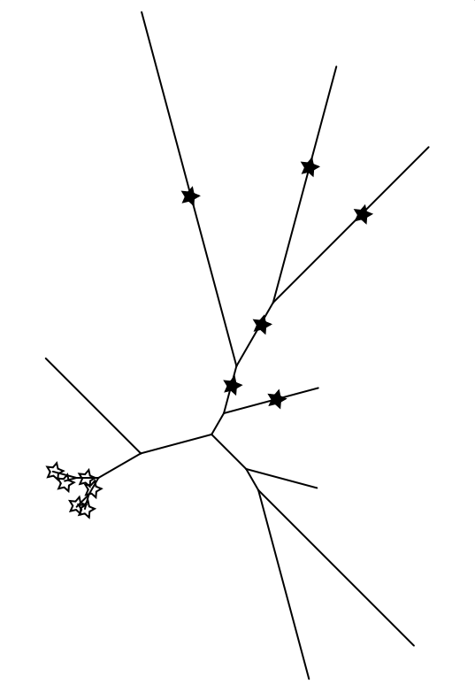
Evolutionary Placement Algorithm
Phylogenetically identification of short query sequences (illumina, 454 etc) using a set of full length reference sequences and a reference tree.
Developed as an alternative to taxonomic assignment based on sequence identity (blast) or homology (hmmer)

Slide 3
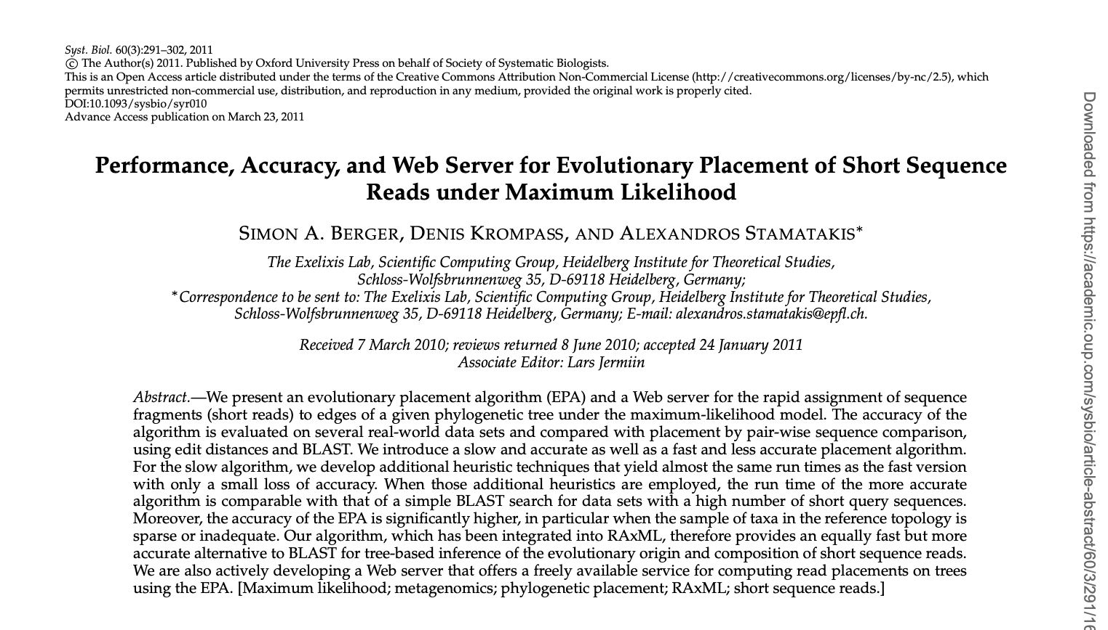

EPA - Evolutionary Placement Algorithm
EPA developed by the Exelixis lab run by A. Stamatakis; Berger et al. (2011)
Similar to pplacer published by Matsen et al. (2010)
Jointly they defined the output format of Phylogenetic Placements in 2012

Slide 4
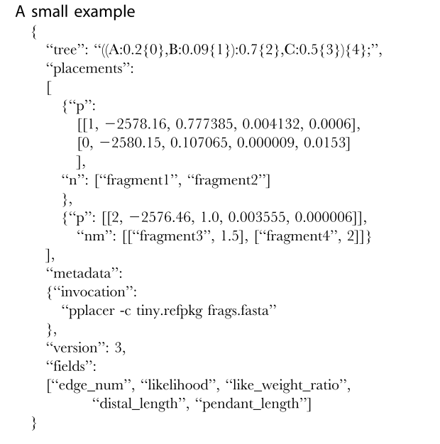

EPA - Evolutionary Placement Algorithm
From the Exelixis lab run by A. Stamatakis; Berger (2011)
Similar to pplacer (Matsen 2010)
Jointly they defined the output format of Phylogenetic Placements in 2012
Matsen et al. (2012)

Slide 5
Why EPA?
Taxonomic assignments with BLAST have shortcomings. Especially when the reference database lacks matches for the query sequence.
Uncertainties in blast hits are hard to evaluate.
What does a low identity score mean?
What does a low e-value mean?
Dependent on fragment length and database size.
Is the hit from the database correctly annotated?

Slide 6
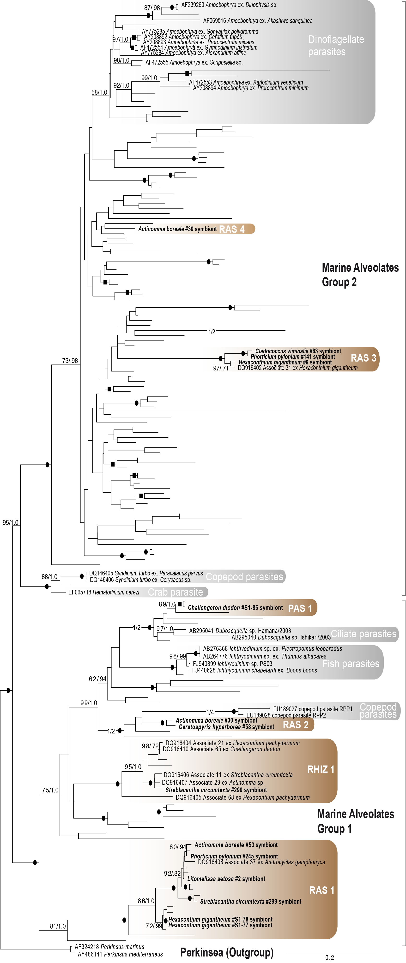
Why EPA?
Phylogeny can be used as an alternative and complementary method to do taxonomic assignment.
Sequences are placed together based on the evolutionary relationship, not annotations from a database.
(if an evolutionary model is used as basis for the phylogenetical tree)
Bråte et al (2012). ML tree of Marine Alveolates, 18S.

Slide 7
Why EPA?
Phylogenies from many short sequences are hard to do because:

Slide 8
Why EPA?
Phylogenies from many short sequences are hard to do because:
Short sequences in general have low phylogenetic resolution.
Often the short fragment used in amplicon sequencing has particularly low phylogenetical signal since it is chosen because of its variability.

Slide 9
Why EPA?
Phylogenies from many short sequences are hard to do because:
The possible rearrangements of a fully resolved phylogenetic tree grows exponentially with the number of taxa added.
The number of unrooted trees for n taxa: (2n-5)!/[2^{n-3}*(n-3)!]
Number of rooted trees for n taxa: (2n-3)!/[2n-2*(n-2)!]
Number of Taxa | Number of unrooted trees | Number of rooted trees
3 | 1 | 3
5 | 15 | 105
10 | 2.02*10⁶ | 3.45*10⁷
20 | 2.22*10²⁰ | 8.20*10²¹
80 | 2.18*10¹³⁷ | 3.43*10¹³⁹

Slide 10
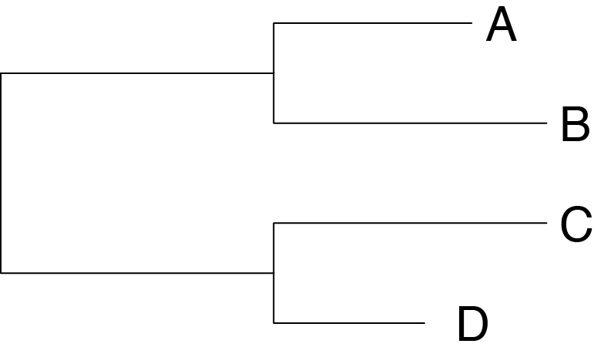
How EPA Works
Query sequences are placed on a reference tree individually by a searching algorithm that tries to find the branch with the best likelihood for the query one at the time.
Since this is done individually for each sequence it is easy to do parallelisation
Query
Sequence
OTU
C
A
D
B
Have to calculate branch length

Slide 11
How EPA Works
Query sequences are placed on a reference tree individually by a searching algorithm that tries to find the branch with the best likelihood for the query one at the time.
Since this is done individually for each sequence it is easy to do parallelisation
Query
Sequence
OTU
C
A
D
B
Have to calculate branch length

Slide 12
How EPA Works
Query sequences are placed on a reference tree individually by a searching algorithm that tries to find the branch with the best likelihood for the query one at the time.
Since this is done individually for each sequence it is easy to do parallelisation
Query
Sequence
OTU
C
A
D
B
Have to calculate branch length

Slide 13
How EPA Works
Query sequences are placed on a reference tree individually by a searching algorithm that tries to find the branch with the best likelihood for the query one at the time.
Since this is done individually for each sequence it is easy to do parallelisation
Query
Sequence
OTU
C
A
D
B
Have to calculate branch length

Slide 14
How EPA Works
Query sequences are placed on a reference tree individually by a searching algorithm that tries to find the branch with the best likelihood for the query one at the time.
Since this is done individually for each sequence it is easy to do parallelisation
Query
Sequence
OTU
C
A
D
B
Have to calculate branch length

Slide 15
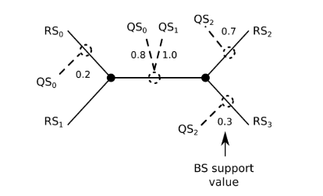
How EPA Works
One query sequence (OTU) can have several placemen
The likelihood for all placements as well as the likelihood weight ratio (lwr) is reported for each OTU.

Slide 16
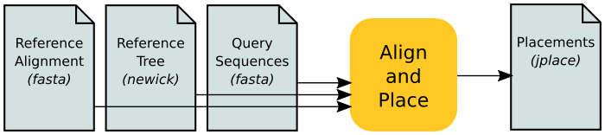
Workflow
Sequencens from GenBank, Pr2 etc.
Aligned with mafft, muscle
RAxML, IQ-tree, Phylobayes etc.
Output from DADA2, usearch, swarm, Illumina data without clustering
- Short read alignment (mafft. PaPaRa)
- EPA or pplacer
Post processing with Gappa (or Guppy, Genesis and others)
https://github.com/lczech/gappa/wiki/Phylogenetic-Placement

Slide 17
Workflow
Alignment with reference sequences for the reference tree
Several programs: MAFFT (good for 18S in nt), Muscle (good for coding genes in aa)
Reference tree.
A tree where you want to place your own OTUs.
Can be made to suit different needs.
For instance a global tree with representatives from all major groups
A tree specific for a phylogenetic group of interest
The model used to infer the reference tree
Alignment with the added OTUs
Mafft --addfragment, PaPaRa

Slide 18
Workflow – Reference tree
Reference tree
Should consist of taxa relevant for your study
Depends on the question you want answered
Example :
Alignment with mafft (linsi algorithm)
Global phylogenetic tree with 331 taxa from the major eukaryotic groups, retrieved from GenBank
Maximum likelihood tree made with RAxML, GTRGAMMA model and 300 bootstraps

Slide 19
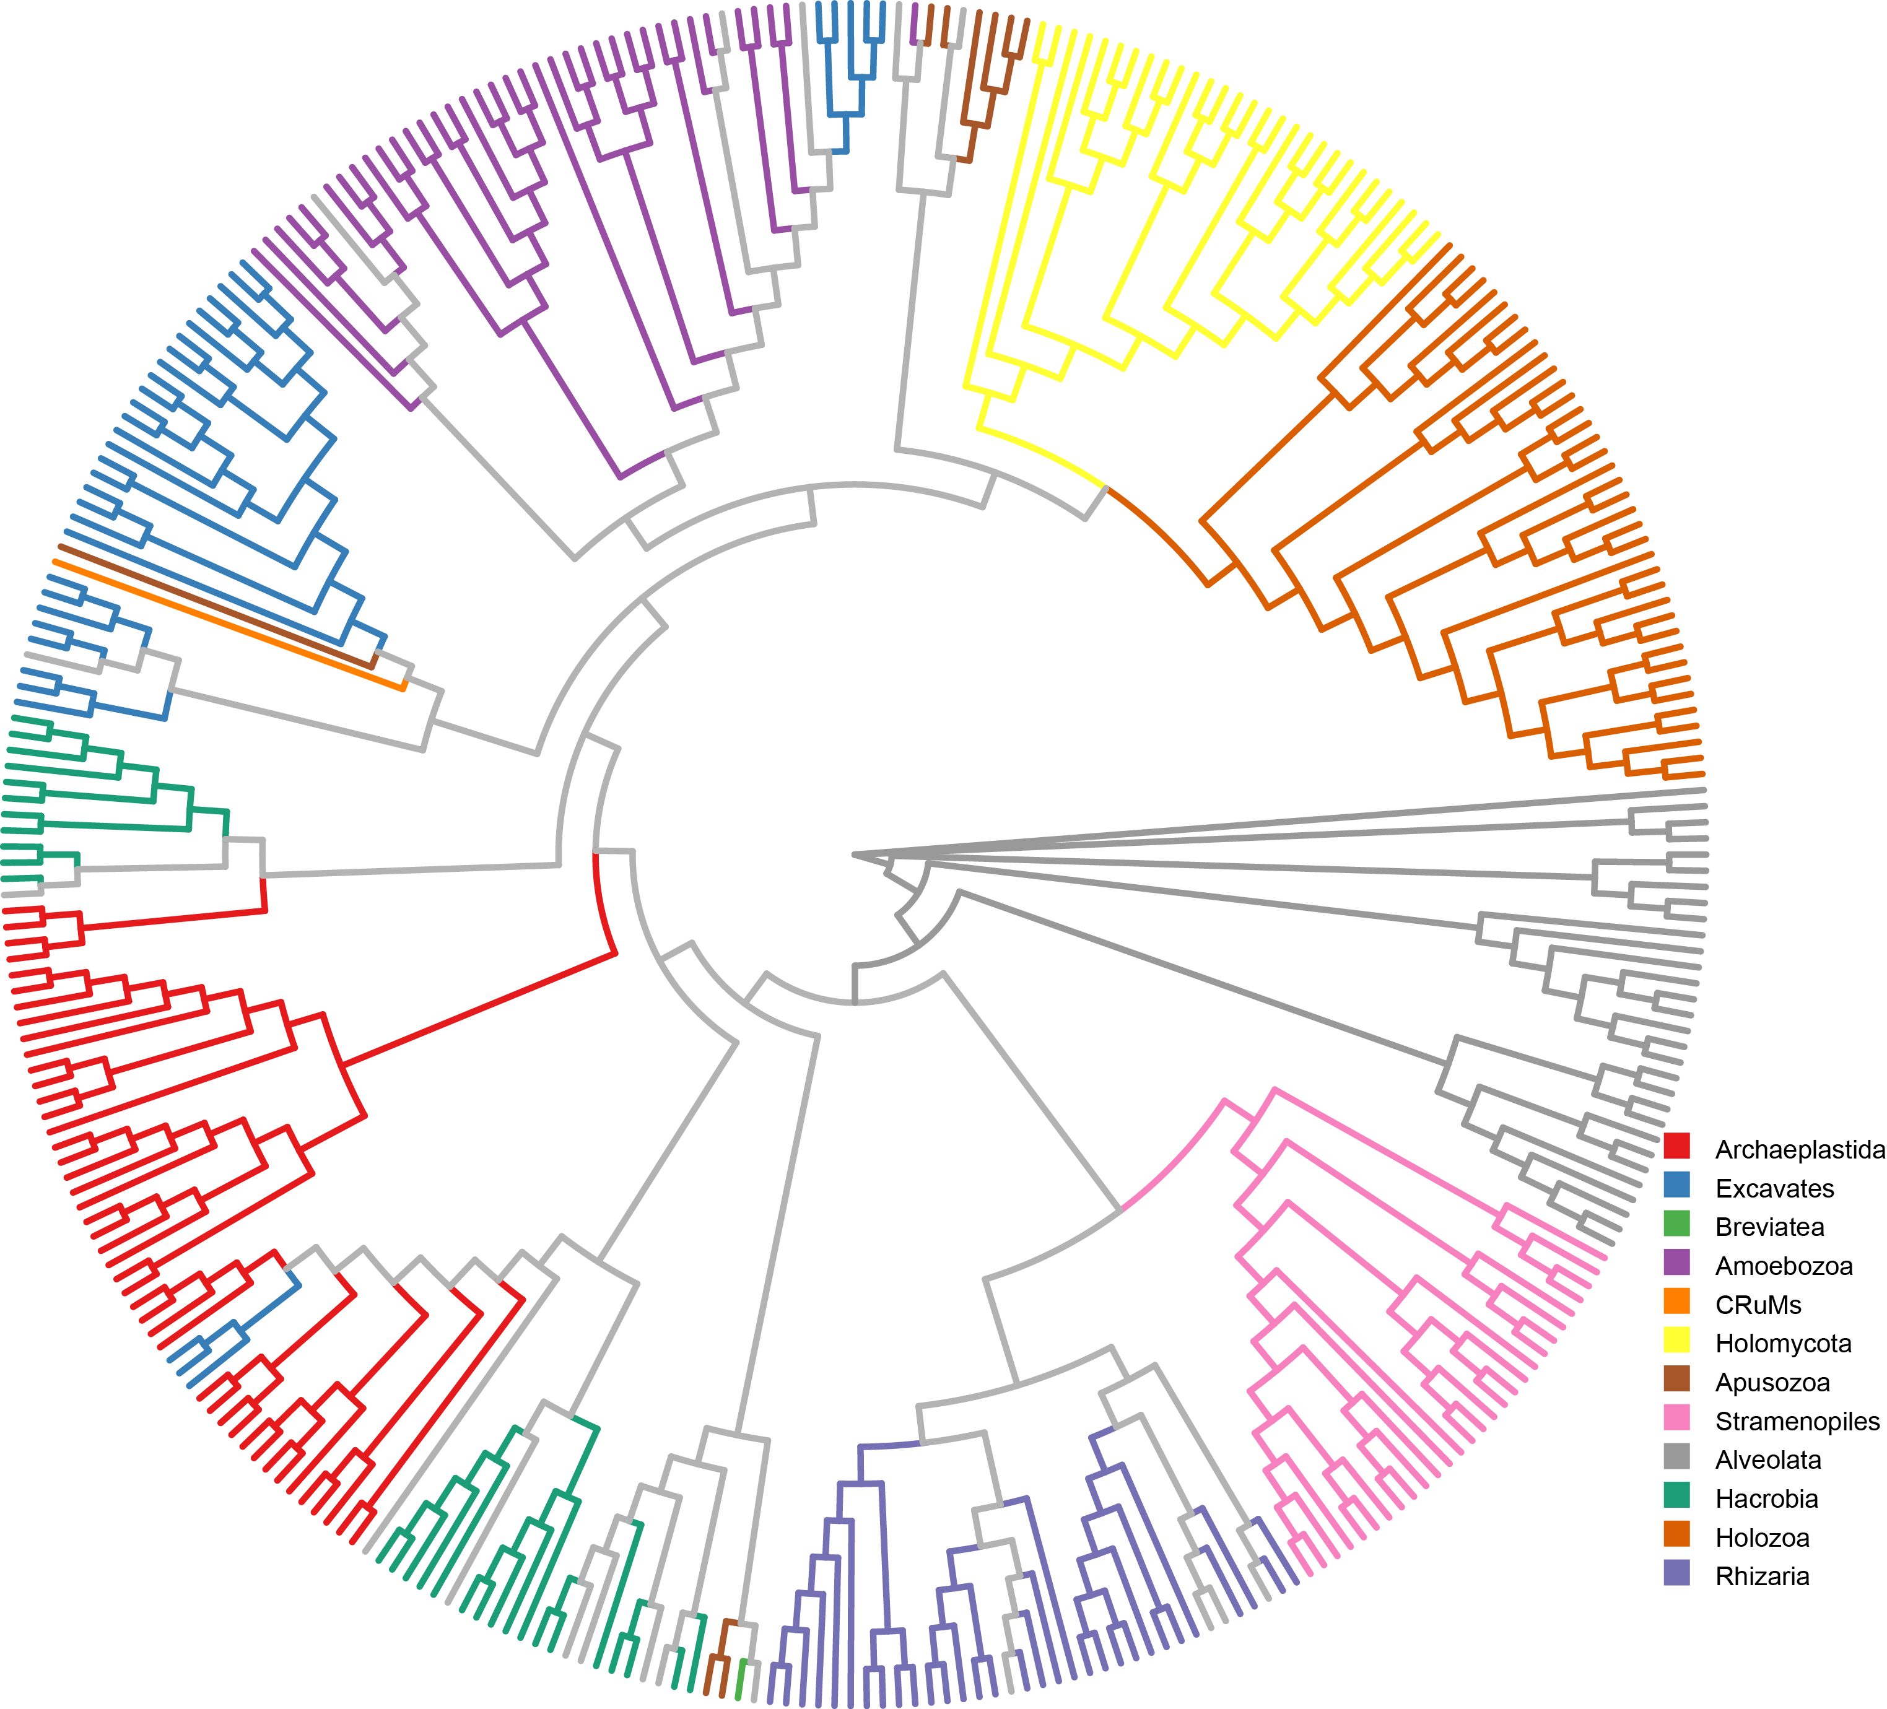
Workflow – Reference tree

Slide 20
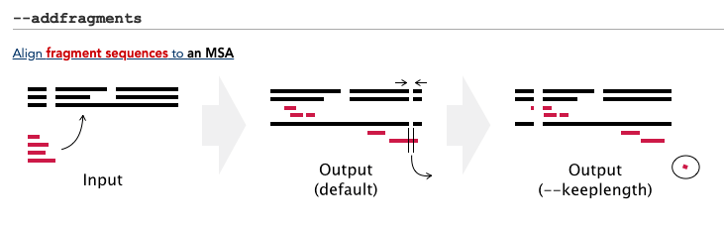
Workflow – Add short sequences to Alignment
Add the shorter OTUs
mafft --addfragment OTUs input > output

Slide 21
Workflow – Place OTUs
RAxML reads the full alignment and the reference tree.
The names of the reference sequences in the alignment and the tips in the tree have to be identical.
RAxML then places the sequences on the reference tree and calculates the likelihood of the placement.

Slide 22
Output : jplace file
The reference tree
Placement information for each query sequence. Each new entry starts with “p”
Optional metadata: in RAxML the command is printed
Version and field definitions

Slide 23
Full tree
313 reference sequences in black.
Placed sequences in red

Slide 24
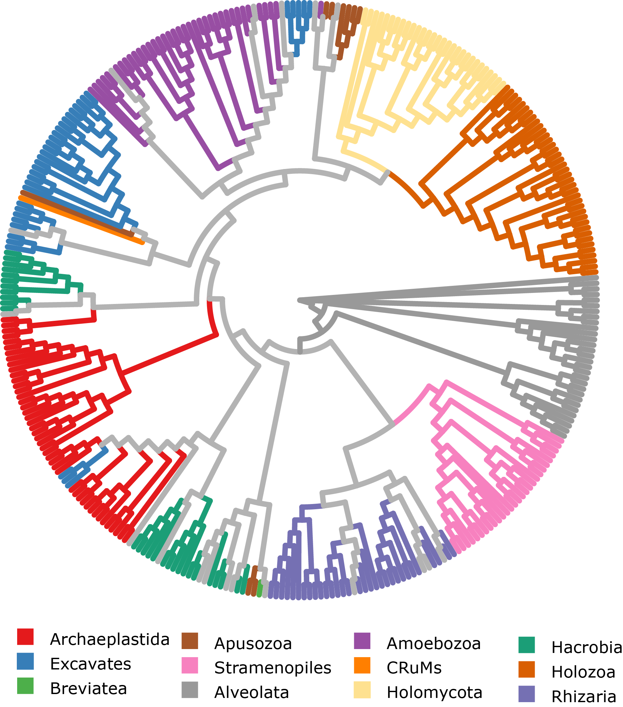
Reference tree
313 full length 18S sequences covering the major branches of the tree of life.
Tree inferred with GTRGAMMA model in RAxML

Slide 25
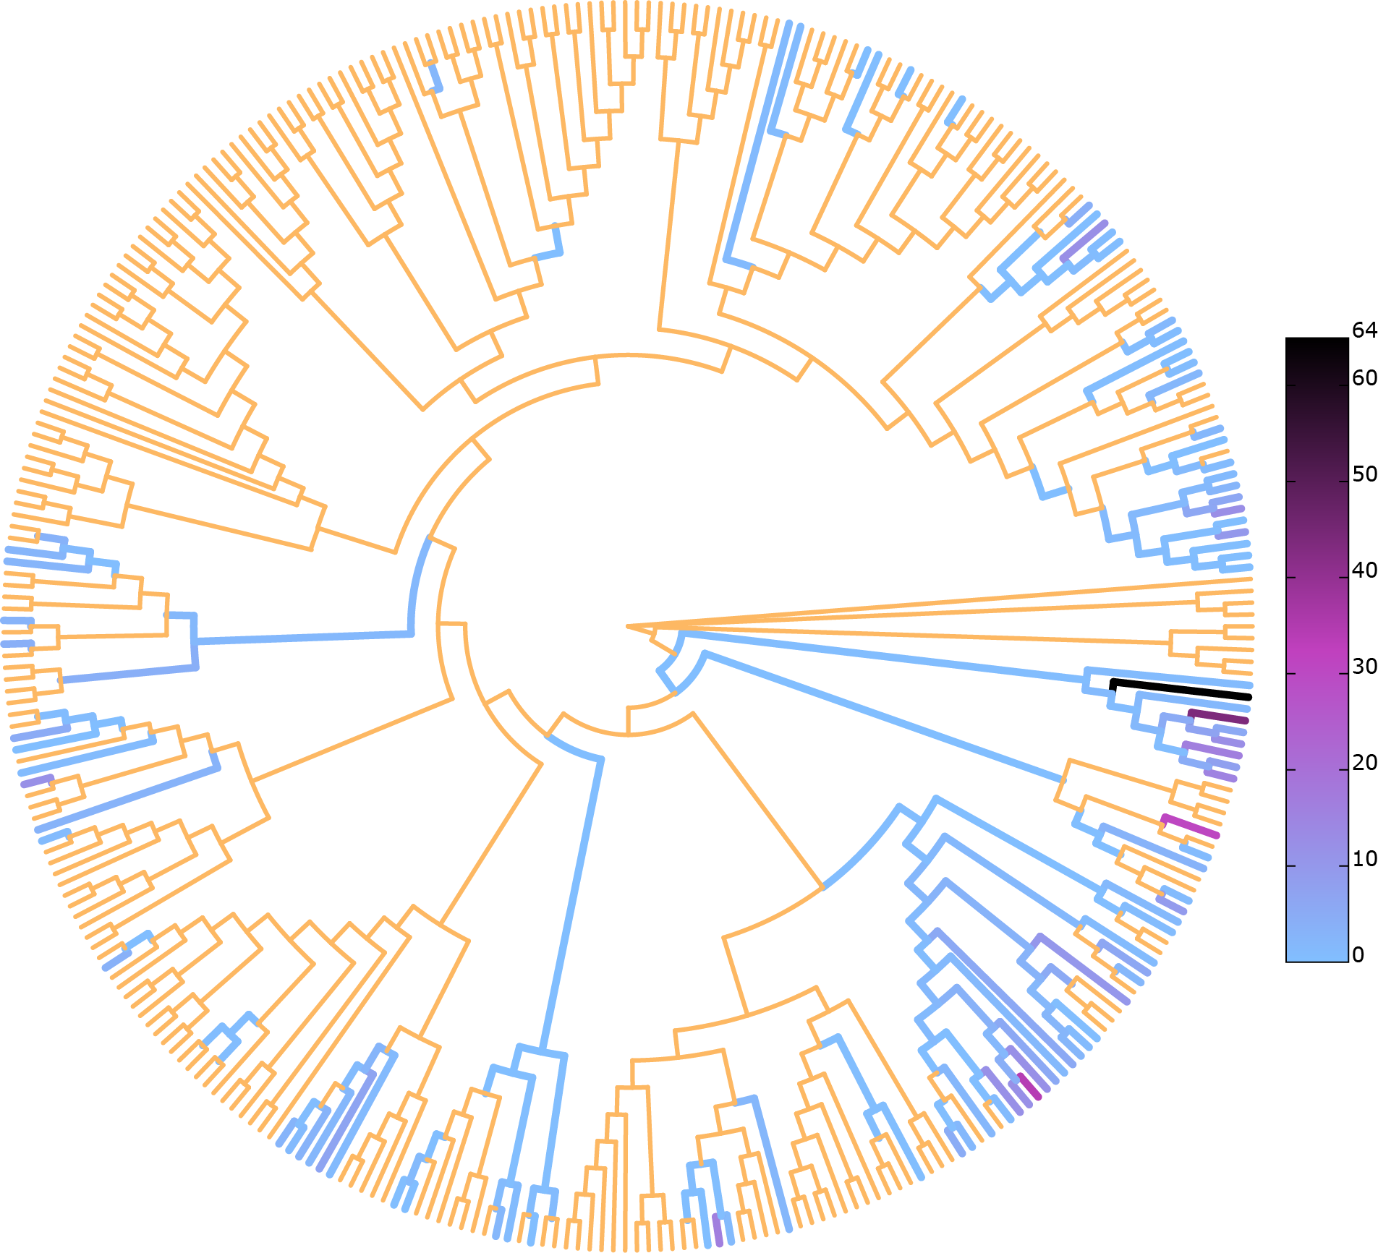
Reference tree
OsloFjord OTUs
Gappa, https://github.com/lczech/gappa/wiki

Slide 26
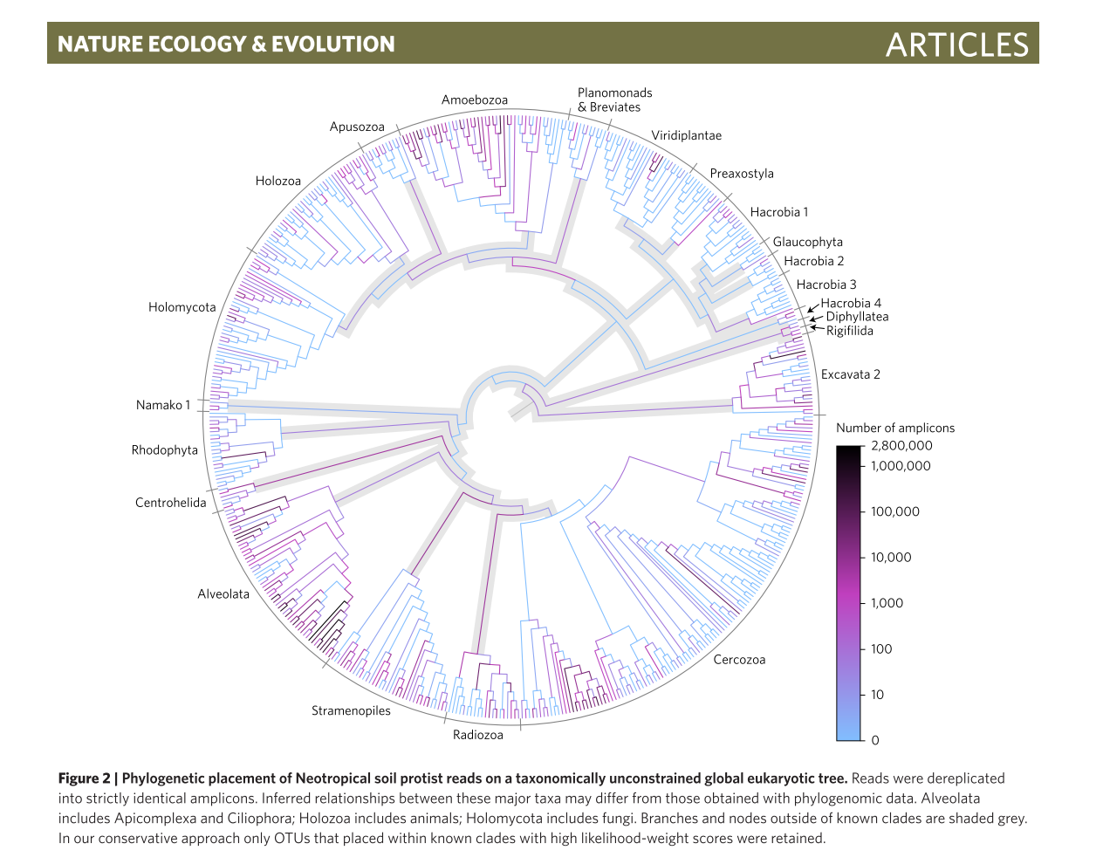
Example
F. Mahé et al. (2017)
10 567 804 amplicons (V4)
Reference tree with 512 full length 18S sequences
RAxML backbone tree
PaPaRa alignment

Slide 27
Exercise
Get resource and load the environment for the course (as before)
qlogin --account ln0002k --mem-per-cpu=3800
source /cluster/software/BIO9905/set.source
The files are in this folder:
/work/tmp/BIO9905MERG1/anderkkr/EPA_exercise/exercise/
The commands etc. for the exercise are in the file called “EPA_scripts.txt”
Already finished files:
Reference tree
Alignment
Placement file (*.jplace) <- This is the output from EPA

Slide 28
Exercise
Some of the processes takes too much time.
Therefore some of the results have been made already:
The global reference with a selection of 331 full length 18S sequences.
linsi --thread 16 Global_eukaryote_18S.fasta > Global_eukaryote_18S_mafft.fasta
Ambigoulsy aligned positions removed with trimal:
trimal -in Global_eukaryote_18S_mafft.fasta -out Global_eukaryote_18S_mafft_trimal.fasta -gt 0.3 -st 0.001
RAxML with bootstraps
mpirun -np 4 raxmlHPC-HYBRID-SSE3 -T 16 -f a -x 666 -m GTRGAMMA -p 666 -# autoMRE -s Global_eukaryote_18S_mafft_trimal.fasta -n autoMRE_rapid_"$STR".tre
Added the shorter (OTUs) to the existing Global alignment
mafft --addfragments OTUs --reorder --thread -1 existing_alignment > Global_eukaryote_18S_mafft_trimal_withOTUs.fasta
Placed the OTUs with RAxML
The flag -f v starts EPA
raxmlHPC-PTHREADS-SSE3 -T 16 -f v -s Global_eukaryote_18S_mafft_trimal_withOTUs.fasta -t RAxML_bestTree.autoMRE_rapid_Global_eukaryote_18S_mafft_trimal.fasta.phy.tre-m GTRGAMMA -n EPA_out
A version of EPA that is supposed to be much faster than the one implemented in RAxML can be found here https://github.com/Pbdas/epa-ng. I have note tested it yet.

Slide 29
Exercise : Post processing of EPA results
Gappa
https://github.com/lczech/gappa/
Reads the jplace file generated by RAxML an gives a range of options for post processing.
E.g.
Colour the reference tree based on the number of assigned OTUs (gappa analyze visualize-color)
Split the OTUs according to matching clades (gappa prepare extract)
Make a fully resolved tree (gappa analyze graf)

Slide 30
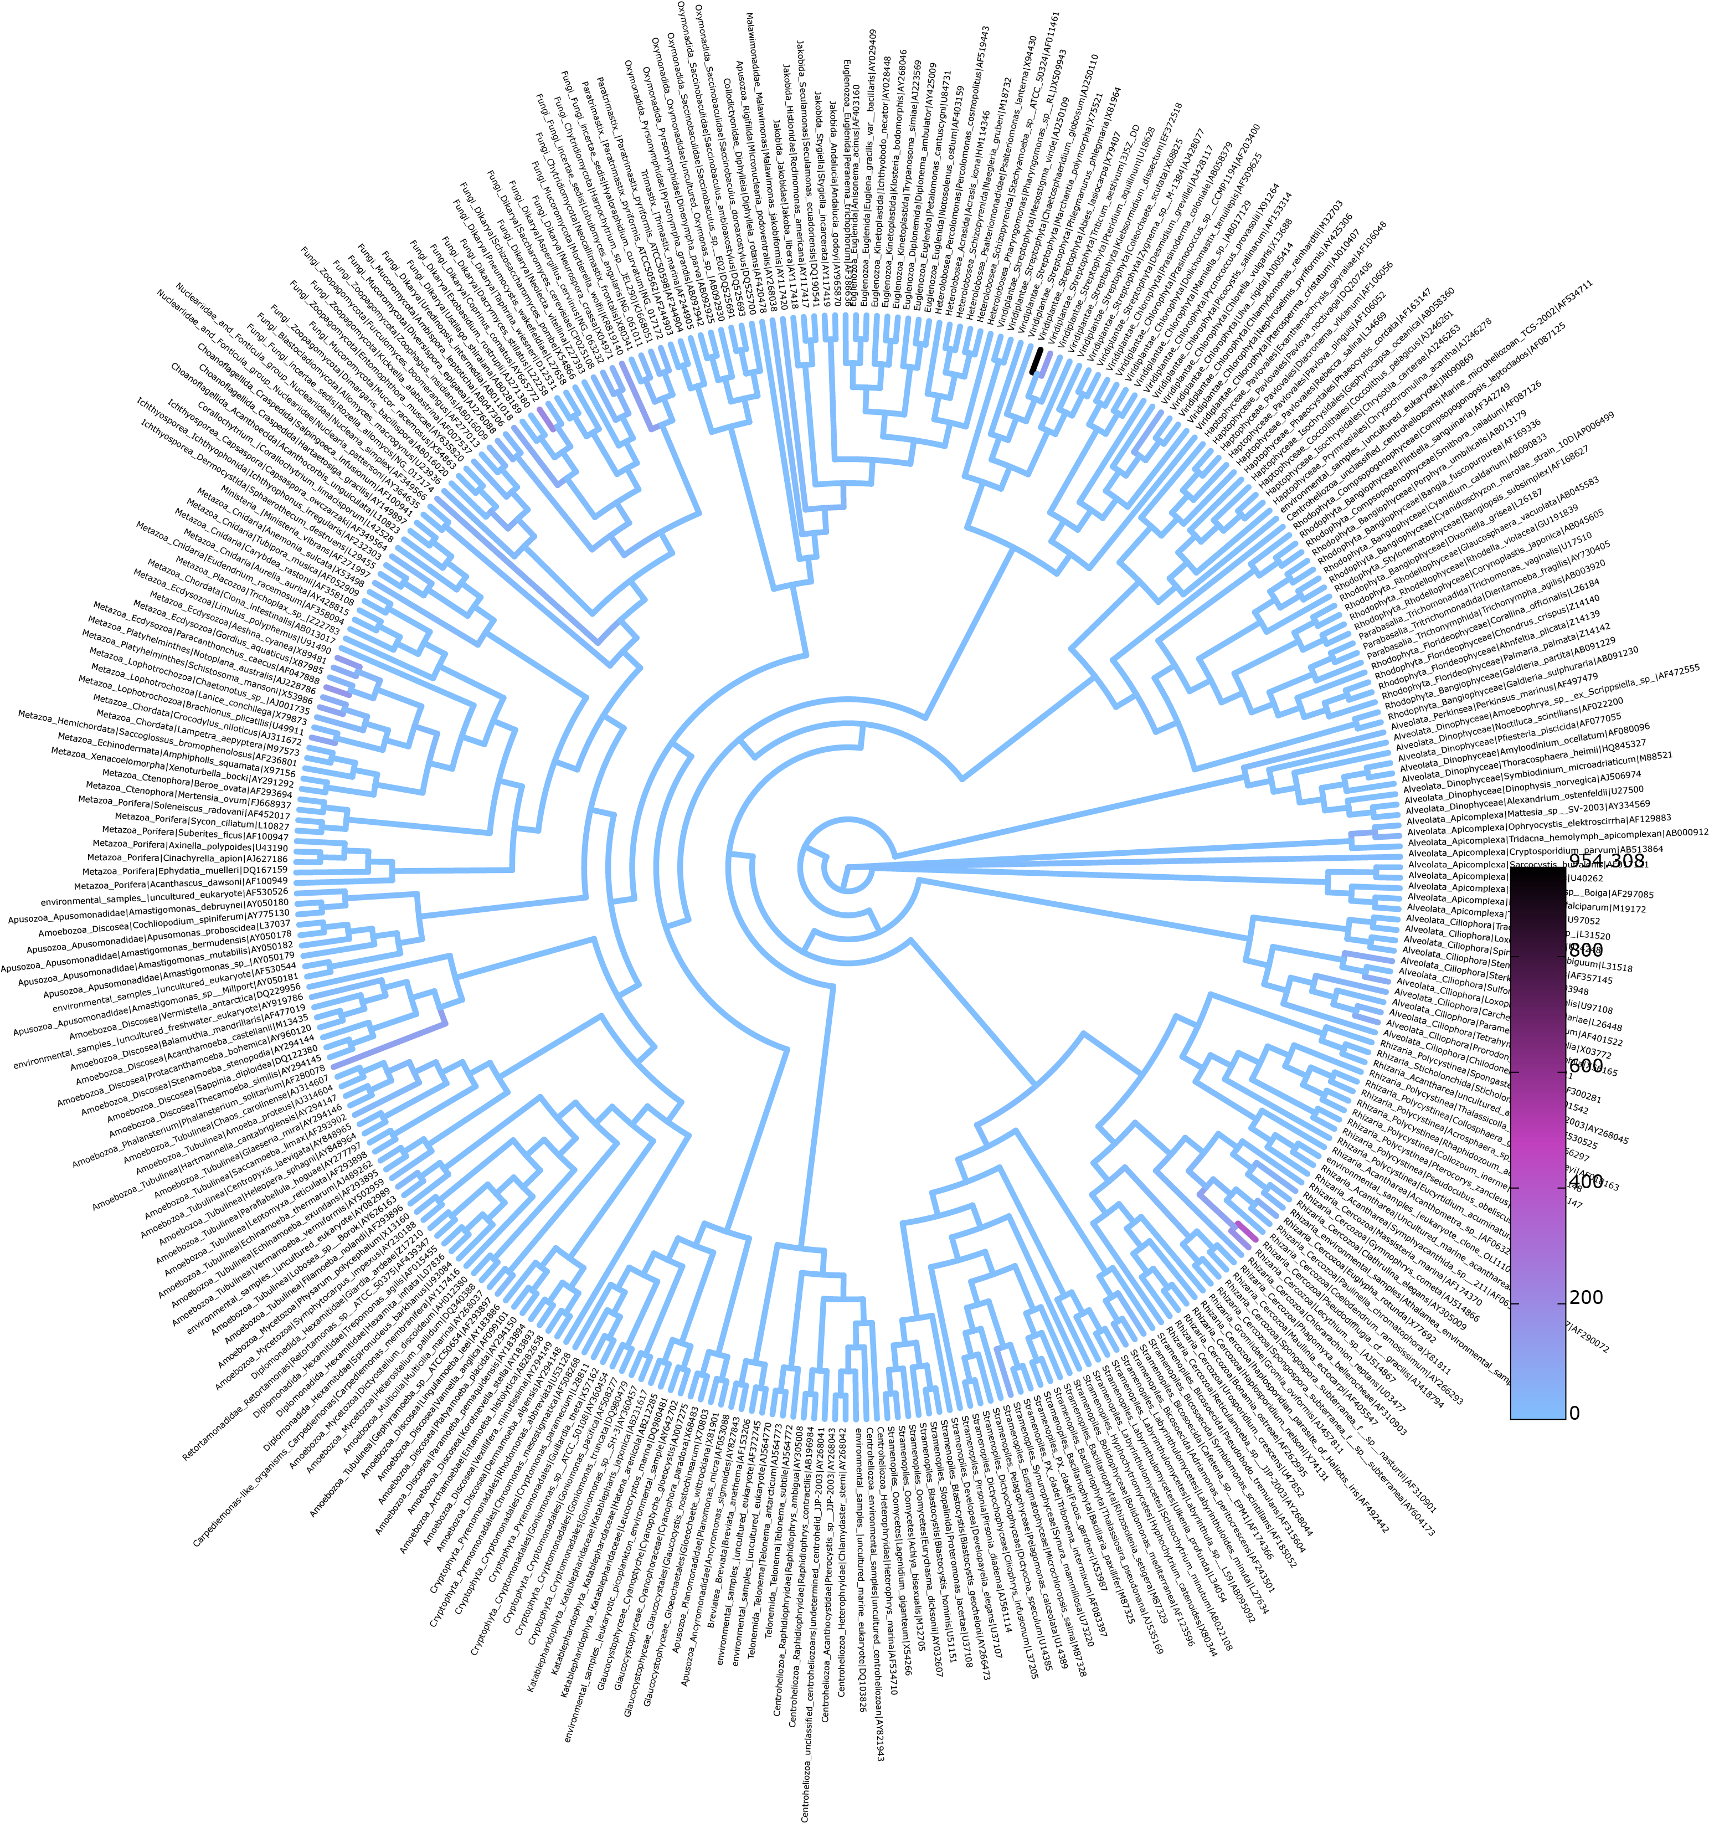

Slide 31
for i in *jplace; do gappa analyze visualize-color --jplace-path $i --out-dir $i.tree/ --write-svg-tree --write-nexus-tree; done

